Slide 1

Flinq
Aljoscha Krettek
Flink committer
co-founder @ data Artisans
aljoscha@apache.org

Slide 2
What is Flink
Large-scale data processing engine
Easy and powerful APIs for batch and real-time streaming analysis (Java / Scala)
Backed by a very robust execution backend
with true streaming capabilities,
custom memory manager,
native iteration execution,
and a cost-based optimizer.

Slide 3
The case for Apache Flink
Performance and ease of use
Exploits in-memory and pipelining, language-embedded logical APIs
Unified batch and real streaming
Batch and Stream APIs on top of a streaming engine
A runtime that "just works" without tuning
custom memory management inside the JVM
Predictable and dependable execution
Bird’s-eye view of what runs and how, and what failed and why

Slide 4

Technology inside Flink
Technology inspired by compilers + MPP databases + distributed systems
For ease of use, reliable performance, and scalability
Data serialization stack
Out-of-core algos
Memory manager
Pre-flight
(client)
Master
Streaming network stack
case class Path (from: Long, to: Long)
val tc = edges.iterate(10) {
paths: DataSet[Path] =>
val next = paths
.join(edges)
.where("to")
.equalTo("from") {
(path, edge) =>
Path(path.from, edge.to)
}
.union(paths)
.distinct()
next
}
Type extraction stack
Recovery metadata
real-time
streaming
Cost-based optimizer
Task scheduling
Workers
...

Slide 5
How do you use Flink?

Slide 6
Example: WordCount
case class Word (word: String, frequency: Int)
val env = ExecutionEnvironment.getExecutionEnvironment()
val lines = env.readTextFile(...)
lines
.flatMap {line => line.split(" ").map(word => Word(word,1))}
.groupBy("word").sum("frequency”)
.print()
env.execute()
Flink has mirrored Java and Scala APIs that offer the same functionality, including by-name addressing.

Slide 7
Flink API in a Nutshell
map, flatMap, filter, groupBy, reduce, reduceGroup, aggregate, join, coGroup, cross, project, distinct, union, iterate, iterateDelta, ...
All Hadoop input formats are supported
API similar for data sets and data streams with slightly different operator semantics
Window functions for data streams
Counters, accumulators, and broadcast variables

Slide 8
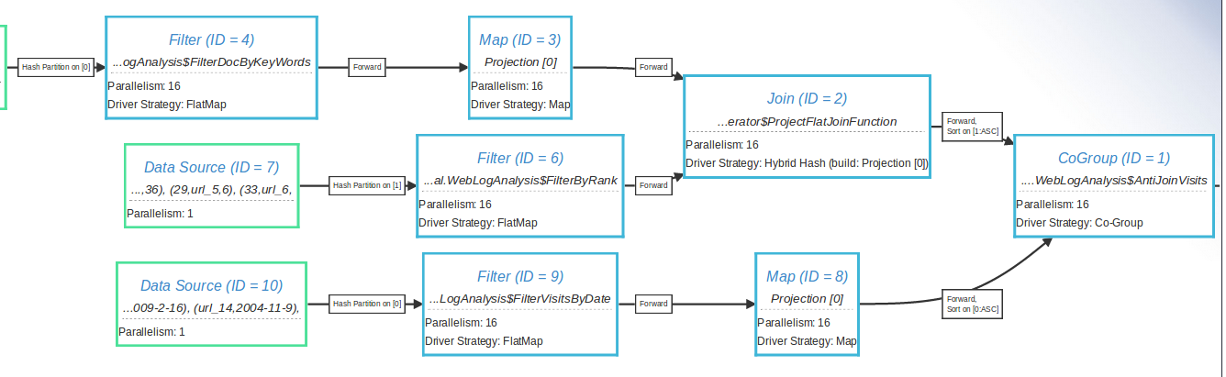
Visualization tools

Slide 9
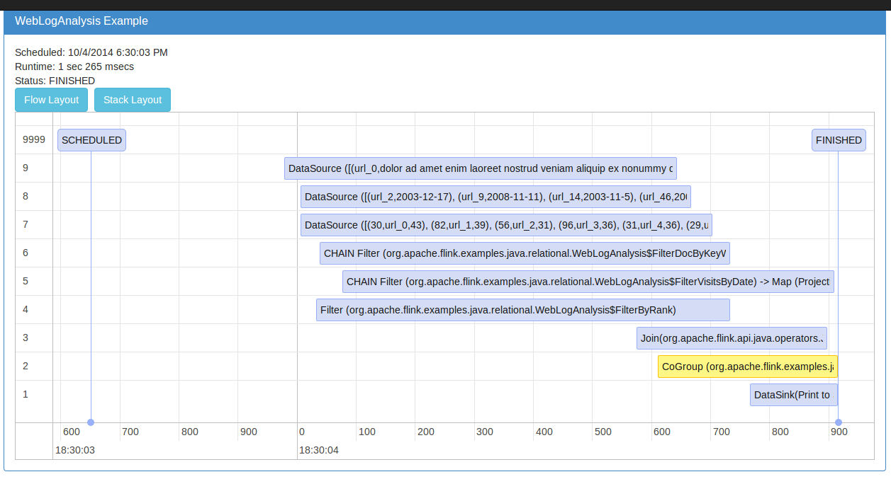
Visualization tools

Slide 10
Flink Architecture

Slide 11
Flink stack
Graph API
(Gelly)
Relational API
Python API
(upcoming)
Streaming ML (SAMOA) (upcoming)
Apache
MRQL
Java & Scala API
Embedded
Environment
(Java collections)
Flink Optimizer
Flink Stream Builder
Flink Runtime Operators
Local
Environment
(for debugging)
Remote Environment
(Cluster execution)
Apache Tez
Single node execution
Standalone or YARN cluster
Data
storage
Files
HDFS
S3
JDBC
HBase
Kafka
Rabbit MQ
Flume
…

Slide 12




Evolution of Architectures
Operator-centric (MapReduce / DAGs)
Operators and DataSets
Dataset-centric
(RDDs)

Slide 13
Operators and Data Sets
Task
Intermediate Result
Task
Intermediate Result
Task
Task
Intermediate Result
Task
Task
Intermediate Result
Intermediate Result
Flink Job Graph

Slide 14


Staged (batch) execution
Subseqent stages:
Grep log for matches
Stage 1:
Create/cache Log
Search for str1
Grep 1
Romeo, Romeo, where art thou Romeo?
Load
Log
Search for str2
Grep 2
Search for str3
Grep 3
Caching in-memory and disk if needed

Slide 15
Pipelined execution
Stage 1:
Deploy and start operators
Note: Log DataSet is never “created”!
Search for str1
Grep 1
Romeo, Romeo, where art thou Romeo?
00110011
00110011
00110011
Load
Log
Search for str2
Grep 2
Search for str3
Grep 3
Data transfer in-memory and disk if needed

Slide 16
Pipelining in Flink
Currently the default mode of operation
Much better performance in many cases – no need to materialize large data sets
Supports both batch and real-time streaming
Currently evolving into a hybrid engine
Batch will use combination of blocking and pipelining
Streaming will use pipelining
Interactive will use blocking

Slide 17
Relational API

Slide 18
First Things First
val clickCounts= clicks
.groupBy('user)
.select('userId, 'url.count as 'count)
val activeUsers = users.join(clickCounts)
.where('id === 'userId && 'count > 10)
.select('username, 'count)

Slide 19
Under the Hood
Logical Plan
&
'a === 'b && 'c > 3
P
=
>
a
c
b
3
F
J
Execution Plan
S
S

Slide 20
Plan Translation
M
Batch Program
P
Plan
generation
G
P
Aggregate
expansion
A
J
F
S
S
F
J
M
J
S
S
S
S
G
Streaming
Program
WJ
S
S
Notes:
Correct operations
TypeInformation is important

Slide 21
More Complex Expressions
in.select('a.substring(0, 'b.avg + 3))
Table result = in.select("a.count + 'the count'")

Slide 22
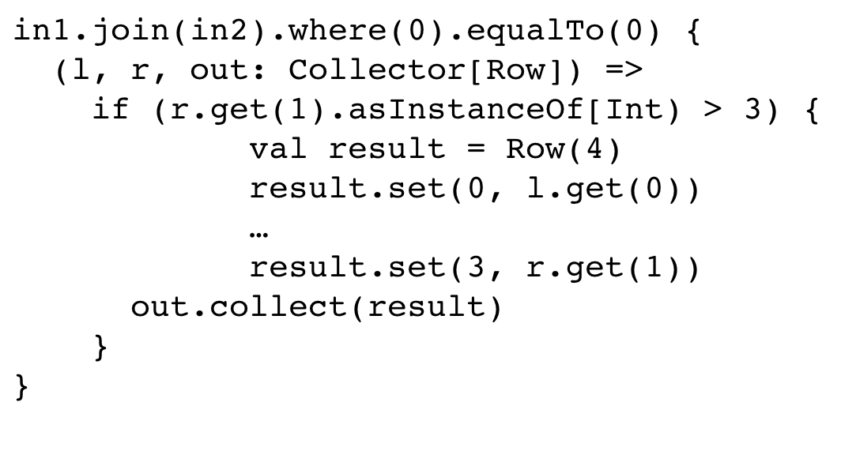
Expression Translation
&
a = c && b > 3
=
>
a
c
b
3
def rules = Seq( new ResolveFieldReferences, new InsertAutoCasts, new TypeCheck, new VerifyNoAggregates, new VerifyBoolean,
new ExtractEquiJoins
)
>
b
3
join({0}, {0})

Slide 23
Expression Translation
in1.join(in2).where(0).equalTo(0) {
(l, r, out: Collector[Row]) =>
if (r.get(1).asInstanceOf[Int) > 3) {
val result = Row(4)
result.set(0, l.get(0))
…
result.set(3, r.get(1))
out.collect(result)
}
}

Slide 24
Back and Forth
case class In(a: Int, b: String)
case class Out(c: String, d: Int)
…
val input: DataSet[In] = …
val in = input.toTable()
val result = in.groupBy("b").select("b, a.avg”)
val output = result.as("c, d").toSet[Out]
Supports POJOs, Case classes, Tuples

Slide 25
Back and Forth
class In { class Out {
public int a; public String c;
public String b; public int d;
} }
…
DataSet<In> input = …
Table table = TableUtil.toTable(input);
Table result = table.groupBy("b").select("b, a.avg");
DataSet<Out> output =
TableUtil.toSet(result.as("c, d"), Out.class);
Supports POJOs, Case classes, Tuples

Slide 26
What Works?
Relational queries from both Java and Scala
Translation to batch programs
Preliminary translation to streaming programs

Slide 27
Future Work
Relational Optimization
Filter/Projection push down
Join order
Operator Fusion
Extend expressions
string operations, casting, explode/gather, date/time, ...
Windowing operations (streaming)
Columnar execution?

Slide 28
Closing

Slide 29
Flink Roadmap for 2015
Exactly-once streaming with flexible state
Support for Google Dataflow
Batch Machine Learning library
Streaming Machine Learning with SAMOA
Graph library additions (more algorithms)
Interactive programs and Zeppelin
SQL on top of Relational API
and more…

Slide 30

flink.apache.org @ApacheFlink

Slide 31
Backup Slides

Slide 32



Slide 33
Flink community
#unique contributors by git commits
(without manual de-dup)
Notes:
dev list: 300-400 messages/month. record 1000 messages on

